Slide 1
Web Search
Interfaces

Slide 2
Web Search Interface
Web search engines of course need a web-based interface.
Search page must accept a query string and submit it within an HTML <form>.
Program on the server must process requests and generate HTML text for the top ranked documents with pointers to the original and/or cached web pages.
Server program must also allow for requests for more relevant documents for a previous query.

Slide 3
Submit Forms
HTML supports various types of program input in forms, including:
Text boxes
Menus
Check boxes
Radio buttons
When user submits a form, string values for various parameters are sent to the server program for processing.
Server program uses these values to compute an appropriate HTML response page.

Slide 4
Simple Search Submit Form
<form action="http://prospero.cs.utexas.edu:8082/servlet/irs.Search" method="POST">
<p> <b> Enter your query: </b>
<input type="text" name="query" size=40>
<p> <b>Search Database: </b>
<select name="directory">
<option selected value="/u/mooney/ir-code/corpora/cs-faculty/"> UT CS Faculty
<option value="/u/mooney/ir-code/corpora/yahoo-science/"> Yahoo Science
</select>
<p> <b>Use Relevance Feedback: </b>
<input type="checkbox" name="feedback" value="1">
<br> <br>
<input type="submit" value="Submit Query">
<input type="reset" value="Reset Form">
</form>

Slide 5
What’s a Servlet?
Java’s answer to CGI programming for processing web form requests.
Program runs on Web server and builds pages on the fly.
When would you use servlets?
Page is based on user-submitted data e.g search engines.
Data changes frequently e.g. weather-reports.
Page uses information from a databases e.g. on-line stores.
Requires running a web server that supports servlets.

Slide 6
Basic Servlet Structure
import java.io.*;
import javax.servlet.*;
import javax.servlet.http.*;
public class SomeServlet extends HttpServlet {
// Handle get request
public void doGet(HttpServletRequest request, HttpServletResponse response) throws ServletException, IOException {
// request – access incoming HTTP headers and HTML form data
// response - specify the HTTP response line and headers
// (e.g. specifying the content type, setting cookies).
PrintWriter out = response.getWriter(); //out - send content to browser
}
}

Slide 7
A Simple Servlet
import java.io.*;
import javax.servlet.*;
import javax.servlet.http.*;
public class HelloWorld extends HttpServlet {
public void doGet(HttpServletRequest request, HttpServletResponse response) throws ServletException, IOException {
PrintWriter out = response.getWriter();
out.println("Hello World");
}
}

Slide 8
Generating HTML
public class HelloWWW extends HttpServlet {
public void doGet(HttpServletRequest request, HttpServletResponse response) throws ServletException, IOException {
response.setContentType("text/html");
PrintWriter out = response.getWriter();
out.println("<HTML>\n" +
"<HEAD><TITLE>HelloWWW</TITLE></HEAD>\n" +
"<BODY>\n" + "<H1>Hello WWW</H1>\n" + "</BODY></HTML>");
}
}

Slide 9
HTML Post Form
<FORM ACTION=“/servlet/hall.ThreeParams”
METHOD=“POST”>
First Parameter: <INPUT TYPE="TEXT" NAME="param1"><BR>
Second Parameter: <INPUT TYPE="TEXT" NAME="param2"><BR>
Third Parameter: <INPUT TYPE="TEXT" NAME="param3"><BR>
<CENTER>
<INPUT TYPE="SUBMIT">
</CENTER>
</FORM>

Slide 10
Reading Parameters
public class ThreeParams extends HttpServlet {
public void doGet(HttpServletRequest request, HttpServletResponse response) throws ServletException, IOException {
response.setContentType("text/html");
PrintWriter out = response.getWriter();
out.println(… +"<UL>\n" +
"<LI>param1: " + request.getParameter("param1") + "\n" +
"<LI>param2: " + request.getParameter("param2") + "\n" +
"<LI>param3: " + request.getParameter("param3") + "\n" +
"</UL>\n" + …);
}
public void doPost(HttpServletRequest request, HttpServletResponse response) throws ServletException, IOException {
doGet(request, response);
}
}

Slide 11
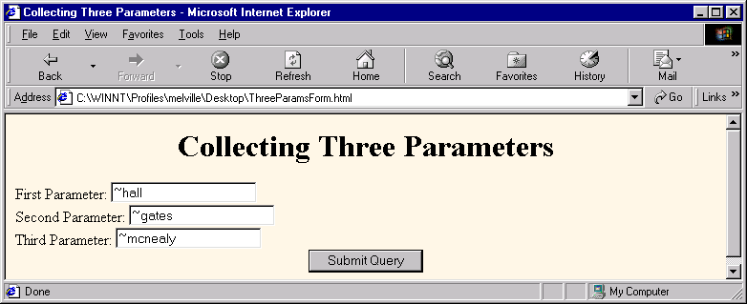
Form Example

Slide 12
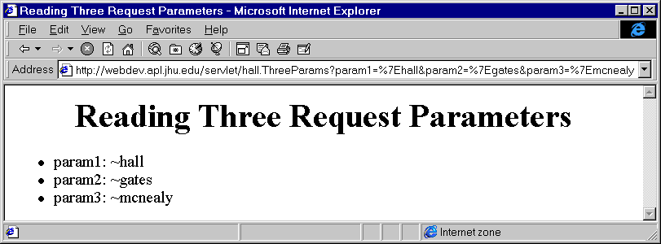
Servlet Output

Slide 13
Session Tracking
Typical scenario – shopping cart in online store.
Necessary because HTTP is a "stateless" protocol.
Common solutions: Cookies and URL-rewriting.
Session Tracking API allows you to:
Look up session object associated with current request.
Create a new session object when necessary.
Look up information associated with a session.
Store information in a session.
Discard completed or abandoned sessions.

Slide 14
Session Tracking API - I
Looking up a session object:
HttpSession session = request.getSession(true);
Pass true to create a new session if one does not exist.
Associating information with session:
session.setAttribute(“user”, request.getParameter(“name”))
Session attributes can be of any type.
Looking up session information:
String name = (String) session.getAttribute(“user”)

Slide 15
Session Tracking API - II
getId
The unique identifier generated for the session.
isNew
true if the client (browser) has never seen the session.
getCreationTime
Time in milliseconds since session was made.
getLastAccessedTime
Time in milliseconds since the session was last sent from client.
getMaxInactiveInterval
# of seconds session should go without access before being invalidated.
Negative value indicates that session should never timeout.

Slide 16
Simple Search Servlet
Based on directory parameter, creates or selects existing InvertedIndex for the appropriate corpus.
Processes the query with VSR to get ranked results.
Writes out HTML ordered list of 10 results starting at the rank of the start parameter.
Each item includes:
Link to the original URL saved by the spider in the top of the document in BASE tag.
Name link with page <TITLE> extracted from file.
Additional link to local cached file.
If all retrievals not already shown, creates a submit form for “More Results” starting from the next ranked item.

Slide 17
Simple Search Interface Refinements
For “More results” requests, stores current ranked list with the user session and displays next set in the list.
Integrates relevance feedback interaction with “radio buttons” for “NEUTRAL,” “GOOD,” and “BAD” in HTML form.

Slide 18
Other Search Interface Refinements
Highlight search terms in the displayed document.
Provided in cached file on Google.
Allow for “advanced” search:
Phrasal search (“..”)
Mandatory terms (+)
Negated term (-)
Language preference
Reverse link
Date preference
Machine translation of pages.

Slide 19
Clustering Results
Group search results into coherent “clusters”:
“microwave dish”
One group of on food recipes or cookware.
Another group on satellite TV reception.
“Austin bats”
One group on the local flying mammals.
One group on the local hockey team.
Northern Light used to group results into “folders” based on a pre-established categorization of pages (like DMOZ categories).
Alternative is to dynamically cluster search results into groups of similar documents.

Slide 20
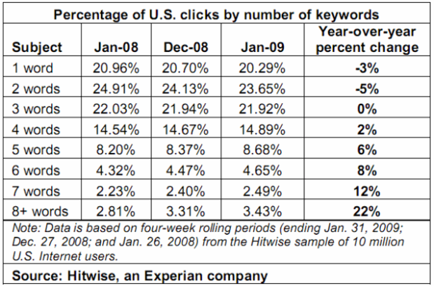
User Query Length
Users tend to enter short queries.
Study in 1998 gave average length of 2.35 words.
Evidence that queries are getting longer.

Slide 21
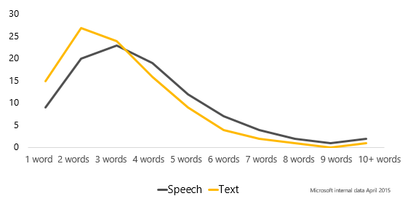
Speech Queries are Longer

